Slide 1
UDP Sockets
Client, Server, (Socket) options
Chapter 8

Slide 2
UDP
Simple
Stateless
Unreliable
APPLICATION
Message Oriented
UDP
IPv4
IPv6

Slide 3
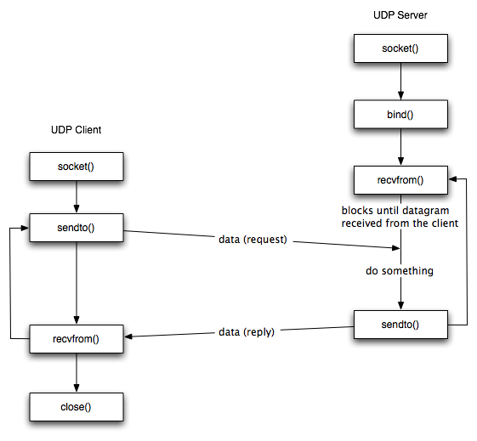
Socket Functions for UDP Client/Server
Application specific

Slide 4
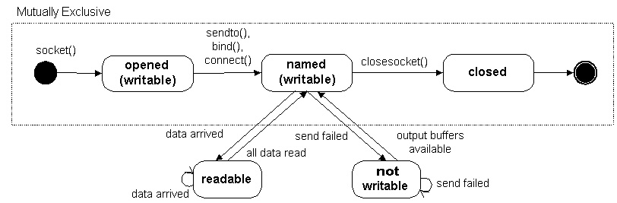
A word on Socket States
Note: Socket State != Protocol State

Slide 5
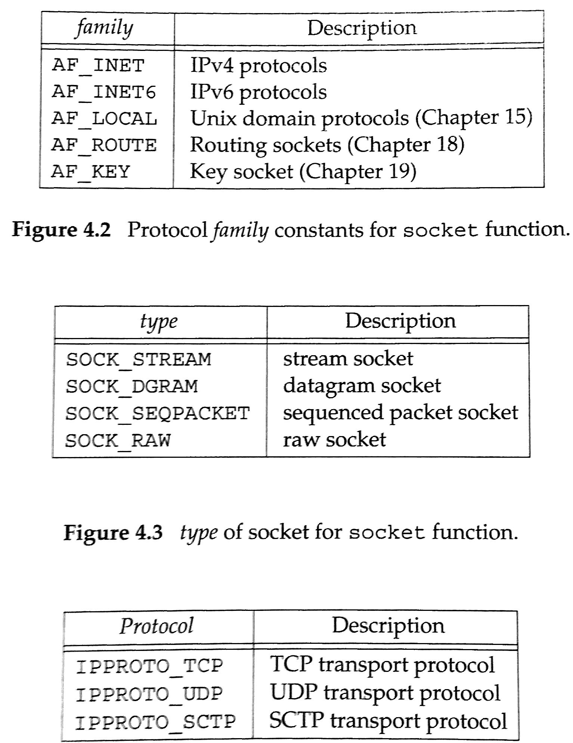
Socket
#include <sys/socket.h>
int socket(int family, int type, int protocol);
On Success, returns a non-negative integer, a socket descriptor.
#include <sys/types.h>
#include <sys/socket.h>
int socket(int domain, int type, int protocol);
Domain
AF_UNIX
AF_LOCAL
AF_INET
AF_INET6
AF_IPX
AF_NETLINK
AF_X25
AF_AX25
AF_ATMPVC
AF_APPLETALK
AF_PACKET
Type
SOCK_STREAM
SOCK_DGRAM
SOCK_SEQPACKET
SOCK_RAW
SOCK_RDM
SOCK_PACKET
Protocol
/etc/protocols
Not all combinations work

Slide 6
Send a Message with UDP
#include <sys/types.h>
#include <sys/socket.h>
ssize_t send(int sockfd, const void *buf, size_t len, int flags);
ssize_t sendto(int sockfd, const void *buf, size_t len, int flags,
const struct sockaddr *dest_addr, socklen_t addrlen);
ssize_t sendmsg(int sockfd, const struct msghdr *msg, int flags);
Socket
#include <unistd.h>
ssize_t write(int fd, const void *buf, size_t count);
File descriptor

Slide 7
Send a Message with UDP
ssize_t send(int sockfd, const void *buf, size_t len, int flags);
Destination needs to be defined in socket
MSG_CONFIRM
MSG_DONTROUTE
MSG_DONTWAIT
MSG_EOR
MSG_MORE
MSG_NOSIGNAL
MSG_OOB
Return Value
On success, these calls return the number of characters sent. On error, -1 is returned, and errno is set appropriately.
len
ssize_t sendto(int sockfd, const void *buf, size_t len, int flags,
const struct sockaddr *dest_addr, socklen_t addrlen);
Destination

Slide 8
Git repo
https://github.com/patrikarlos/networkprogramming

Slide 9
/*
** talker.c -- a datagram "client" demo
*/
#include <stdio.h>
#include <stdlib.h>
#include <unistd.h>
#include <errno.h>
#include <string.h>
#include <sys/types.h>
#include <sys/socket.h>
#include <netinet/in.h>
#include <arpa/inet.h>
#include <netdb.h>
#define SERVERPORT "4950" // the port users will be connecting to
int main(int argc, char *argv[])
{
int sockfd;
struct addrinfo hints, *servinfo, *p;
int rv;
int numbytes;
External Viewer

Slide 10
memset(&hints, 0, sizeof hints);
hints.ai_family = AF_UNSPEC;
hints.ai_socktype = SOCK_DGRAM;
if ((rv = getaddrinfo(argv[1], SERVERPORT, &hints, &servinfo)) != 0) {
fprintf(stderr, "getaddrinfo: %s\n", gai_strerror(rv));
return 1;
}
// loop through all the results and make a socket
for(p = servinfo; p != NULL; p = p->ai_next) {
if ((sockfd = socket(p->ai_family, p->ai_socktype, p->ai_protocol)) == -1) {
perror("talker: socket");
continue;
}
break;
}
External Viewer

Slide 11
if (p == NULL) {
fprintf(stderr, "talker: failed to create socket\n");
return 2;
}
if ((numbytes = sendto(sockfd, argv[2], strlen(argv[2]), 0, p->ai_addr, p->ai_addrlen)) == -1) {
perror("talker: sendto");
exit(1);
}
freeaddrinfo(servinfo);
printf("talker: sent %d bytes to %s\n", numbytes, argv[1]);
close(sockfd);
return 0;
}
External Viewer

Slide 12
getaddrinfo
#include <sys/types.h>
#include <sys/socket.h>
#include <netdb.h>
int getaddrinfo(const char *node, const char *service,
const struct addrinfo *hints,
struct addrinfo **res);
void freeaddrinfo(struct addrinfo *res);
const char *gai_strerror(int errcode);
Given node and service, which identify an Internet host and a service, getaddrinfo() returns one or more addrinfo structures, each of which contains an Internet address that can be specified in a call to bind(2) or connect(2). The getaddrinfo() function combines the functionality provided by the gethostbyname(3) and getservbyname(3) functions into a single interface, but unlike the latter functions, getaddrinfo() is reentrant and allows programs to eliminate IPv4-versus-IPv6 dependencies.
http://man7.org/linux/man-pages/man3/getaddrinfo.3.html

Slide 13
using send….
if (connect(sockfd,p->ai_addr, p->ai_addrlen) < 0 ) {
perror("talker2: connect .\n");
exit(1);
}
if ((numbytes = send(sockfd, argv[2], strlen(argv[2]), 0)) == -1) {
perror("talker2: sendto");
exit(1);
}
Associate destination address with socket.

Slide 14
Receive/Read a Message with UDP
#include <sys/types.h>
#include <sys/socket.h>
ssize_t recv(int sockfd, void *buf, size_t len, int flags);
ssize_t recvfrom(int sockfd, void *buf, size_t len, int flags,
struct sockaddr *src_addr, socklen_t *addrlen);
ssize_t recvmsg(int sockfd, struct msghdr *msg, int flags);
Socket
#include <unistd.h>
ssize_t read(int fd, void *buf, size_t count);
File descriptor

Slide 15
Receive a Message with UDP
ssize_t recv(int sockfd, void *buf, size_t len, int flags);
Destination needs to be defined in socket
MSG_CONFIRM
MSG_DONTROUTE
MSG_DONTWAIT
MSG_EOR
MSG_MORE
MSG_NOSIGNAL
MSG_OOB
len
Return Value
Returns the number of bytes received (could be less than len), or -1 on error.
ssize_t recvfrom(int sockfd, void *buf, size_t len, int flags,
struct sockaddr *src_addr, socklen_t *addrlen);
Destination

Slide 16
Example, recv()
// stream sockets and recv()
struct addrinfo hints, *res;
int sockfd;
char buf[512];
int byte_count;
// get host info, make socket, and connect it
memset(&hints, 0, sizeof hints);
hints.ai_family = AF_UNSPEC; // use IPv4 or IPv6, whichever
hints.ai_socktype = SOCK_STREAM;
getaddrinfo("www.example.com", "3490", &hints, &res);
sockfd = socket(res->ai_family, res->ai_socktype, res->ai_protocol);
connect(sockfd, res->ai_addr, res->ai_addrlen);
// all right! now that we're connected, we can receive some data!
byte_count = recv(sockfd, buf, sizeof buf, 0);
printf("recv()'d %d bytes of data in buf\n", byte_count);
https://beej.us/guide/bgnet/html/multi/recvman.html

Slide 17
Example, recvfrom()
struct addrinfo hints, *res;
int sockfd;
int byte_count;
socklen_t fromlen;
struct sockaddr_storage addr;
char buf[512];
char ipstr[INET6_ADDRSTRLEN];
// get host info, make socket, bind it to port 4950
memset(&hints, 0, sizeof hints);
hints.ai_family = AF_UNSPEC; // use IPv4 or IPv6, whichever
hints.ai_socktype = SOCK_DGRAM;
hints.ai_flags = AI_PASSIVE;
getaddrinfo(NULL, "4950", &hints, &res);
sockfd = socket(res->ai_family, res->ai_socktype, res->ai_protocol);
bind(sockfd, res->ai_addr, res->ai_addrlen);
// no need to accept(), just recvfrom():
fromlen = sizeof addr;
byte_count = recvfrom(sockfd, buf, sizeof buf, 0, &addr, &fromlen);
printf("recv()'d %d bytes of data in buf\n", byte_count);
printf("from IP address %s\n",inet_ntop(addr.ss_family, addr.ss_family == AF_INET?((struct sockadd_in *)&addr)->sin_addr:((struct sockadd_in6 *)&addr)->sin6_addr, ipstr, sizeof ipstr);
https://beej.us/guide/bgnet/html/multi/recvman.html

Slide 18
server
client
client
Socket receiver buffer
UDP
UDP
UDP
No order on reception or from whom?

Slide 19
Summary of UDP Example
Socket()
Sendto()
client
server
UDP
Client ephemeral port
Chosen by UDP
Specify server’s
port
UDP
IP
Client IP address
Chosen by IP
(based on destination/routing)
Specify server’s
IP address
IP
datalink
datalink

Slide 20
Summary of UDP Example
recvfrom
client
socket()
bind()
server
UDP
Return client’s port
Specify server’s
port
UDP
IP
Return client’s IP address
IP
Specify server’s
IP address
(normally wildcard)
datalink
datalink

Slide 21
Connect on UDP
Kernel checks for errors, records IP and port of the peer (from sockaddr).
Cannot use sendto → send or write
Cannot use recvfrom → recv or read
Asyncronous errors are returned to the process

Slide 22
application
read
write
peer
UDP
Connect() stores peer IP address and port no.
UDP

Slide 23
Multiple (sequential) connects
Specify new IP and port
To unconnect

Slide 24
UDP and it’s lack of flow control
Application
Each Socket has a buffer.
SO_RCVBUF
read
write
Socket
Kernel
read
write

Slide 25
Socket Options
#include <sys/types.h>
#include <sys/socket.h>
int getsockopt(int sockfd, int level, int optname, void *optval, socklen_t *optlen);
int setsockopt(int sockfd, int level, int optname, const void*optval, socklen_t optlen);

Slide 26
Linux <Sys/Socket.h>
SO_ACCEPTCONN Socket is accepting connections.
SO_BROADCAST Transmission of broadcast messages is supported.
SO_DEBUG Debugging information is being recorded.
SO_DONTROUTE bypass normal routing
SO_ERROR Socket error status.
SO_KEEPALIVE Connections are kept alive with periodic messages.
SO_LINGER Socket lingers on close.
SO_OOBINLINE Out-of-band data is transmitted in line.
SO_RCVBUF Receive buffer size.
SO_RCVLOWAT receive "low water mark"
SO_RCVTIMEO receive timeout
SO_REUSEADDR Reuse of local addresses is supported.
SO_SNDBUF Send buffer size.
SO_SNDLOWAT send "low water mark"
SO_SNDTIMEO send timeout
SO_TYPE Socket type

Slide 27
Socket Functions for UDP Client/Server
Application specific

Slide 28
Application Protocol
Client
Server
Client
Server
Who drives the communication?
Direction of data flow?
Where could a bottleneck occur?
Single / Multiple clients?

